Slide 1
Module 5 - Business Data Analytics
(17 hours)
Notes:
Title - The learning outcome
Subtitle - Duration

Slide 2
Understand business analytics and develop business intelligence.
Notes:
Title - The learning outcome
Subtitle - Duration

Slide 3
In this section, we will discuss:
Introduction to business analytics and concepts of business analytics.
Trends in business analytics.
Introduction to Big Data Analytics
Notes:
Mention the parent topics one by one. This particular learning outcome has 4 parent topics.

Slide 4
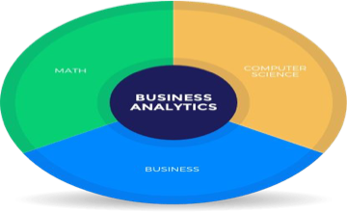
Introduction to business analytics and Concepts of business analytics
What is Business Analytics?
Business analytics (BA) is the iterative, methodical exploration of an organization's data, with an emphasis on statistical analysis.
Business analytics is used by companies that are committed to making data-driven decisions.
Image Source: https://www.businessanalytics.com/
Notes:
Left (White Color space):
Title - Parent Topic
Subtitle - Subtopic 1
Body Text - Description in bullets
Right (Grey Color Space):
Body Text - Relevant image (with source)/code snippet
Put reference links in Speaker Notes
Reference:
https://www.tutorialspoint.com/internet_technologies/internet_overview.htm/

Slide 5
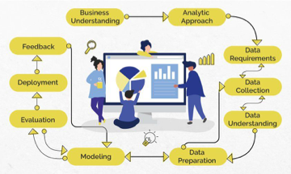
Introduction to business analytics and Concepts of business analytics
What is Business Analytics?(Contd)
Business Analytics is "the study of data through statistical and operations analysis, the formation of predictive models, application of optimization techniques, and the communication of these results to customers, business partners, and college executives”.
Image Source: https://www.proschoolonline.com/certification-business-analytics-course/what-is-b
Notes:
Left (White Color space):
Title - Parent Topic
Subtitle - Subtopic 1
Body Text - Description in bullets
Right (Grey Color Space):
Body Text - Relevant image (with source)/code snippet
Put reference links in Speaker Notes
Reference:
https://www.tutorialspoint.com/internet_technologies/internet_overview.htm/

Slide 6
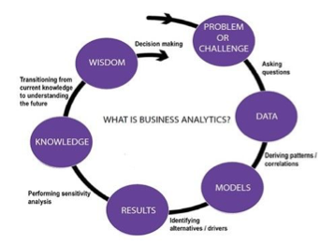
Introduction to business analytics and Concepts of business analytics
What is Business Analytics?(Contd)
It adopts quantitative methods and evidence is required for data to build certain models for businesses and make profitable decisions. Thus, Business Analytics majorly depends on and uses Big Data( large volume of data) .
Image Source: https://www.altudo.co/resources/blogs/business-analytics-vs-marketing-analytics-
Notes:
Left (White Color space):
Title - Parent Topic
Subtitle - Subtopic 1
Body Text - Description in bullets
Right (Grey Color Space):
Body Text - Relevant image (with source)/code snippet
Put reference links in Speaker Notes
Reference:
https://www.tutorialspoint.com/internet_technologies/internet_overview.htm/

Slide 7
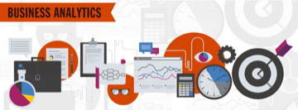
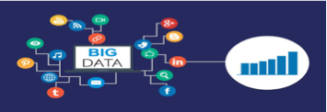
Introduction to business analytics and Concepts of business analytics
Understanding Business Analytics
Business Analytics is the procedure through which information is dissected after studying past performances and issues, to devise a successful plan for the future.
Big Data or large amounts of data is used to derive solutions.
Image Source: https://www.indiaeducation.net/management/streams/business-analytics.html
Notes:
Left (White Color space):
Title - Parent Topic
Subtitle - Subtopic 1
Body Text - Description in bullets
Right (Grey Color Space):
Body Text - Relevant image (with source)/code snippet
Put reference links in Speaker Notes
Reference:
https://www.tutorialspoint.com/internet_technologies/internet_overview.htm/

Slide 8
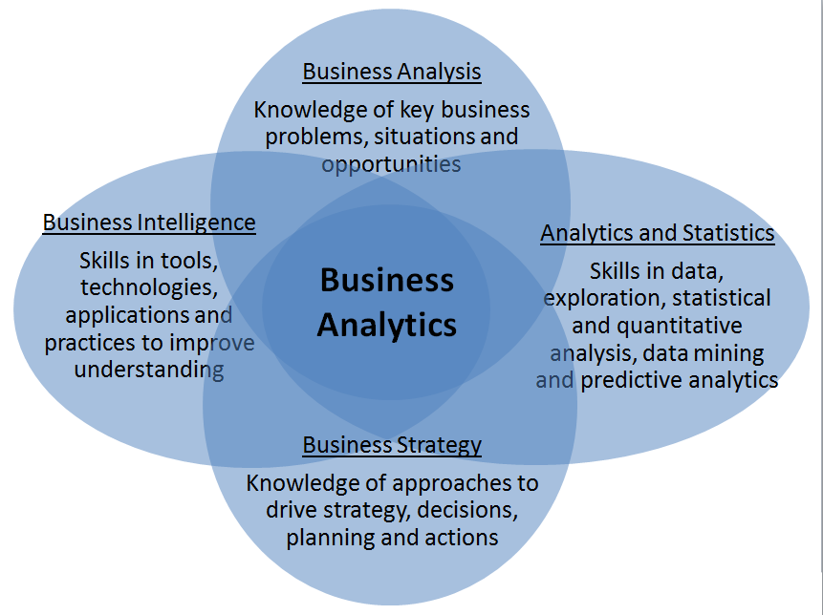
Introduction to business analytics and Concepts of business analytics
Understanding Business Analytics
This method of going about a business or this outlook towards building and sustaining a business is vital to the economy and industries that thrive in the economy.
Image Source: https://www.martinsights.com/?p=1049
Notes:
Left (White Color space):
Title - Parent Topic
Subtitle - Subtopic 1
Body Text - Description in bullets
Right (Grey Color Space):
Body Text - Relevant image (with source)/code snippet
Put reference links in Speaker Notes
Reference:
https://www.tutorialspoint.com/internet_technologies/internet_overview.htm/

Slide 9
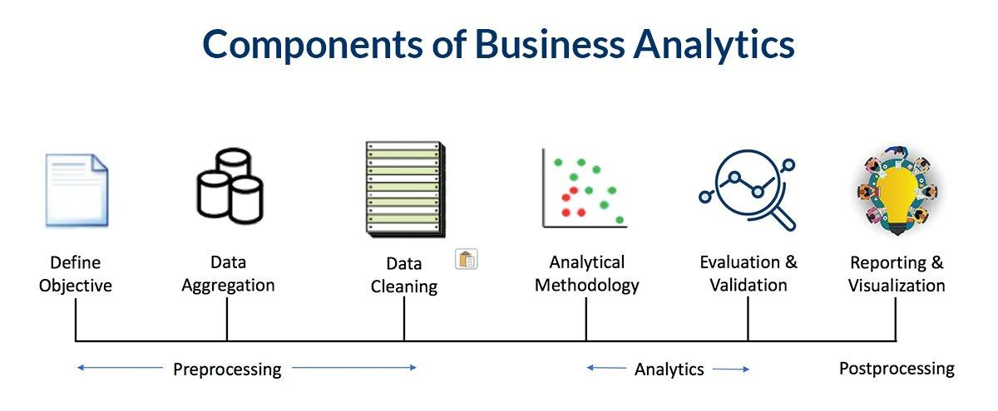
Introduction to business analytics and Concepts of business analytics
Components of Business Analytics
Define Objective
Data Aggregation
Data Cleaning
Analytical Methodology
Evaluation and Validation
Reporting and Data Visualisation
Image Source: https://www.analytixlabs.co.in/blog/what-is-business-analytics
Notes:
Left (White Color space):
Title - Parent Topic
Subtitle - Subtopic 1
Body Text - Description in bullets
Right (Grey Color Space):
Body Text - Relevant image (with source)/code snippet
Put reference links in Speaker Notes
Reference:
https://www.tutorialspoint.com/internet_technologies/internet_overview.htm/

Slide 10
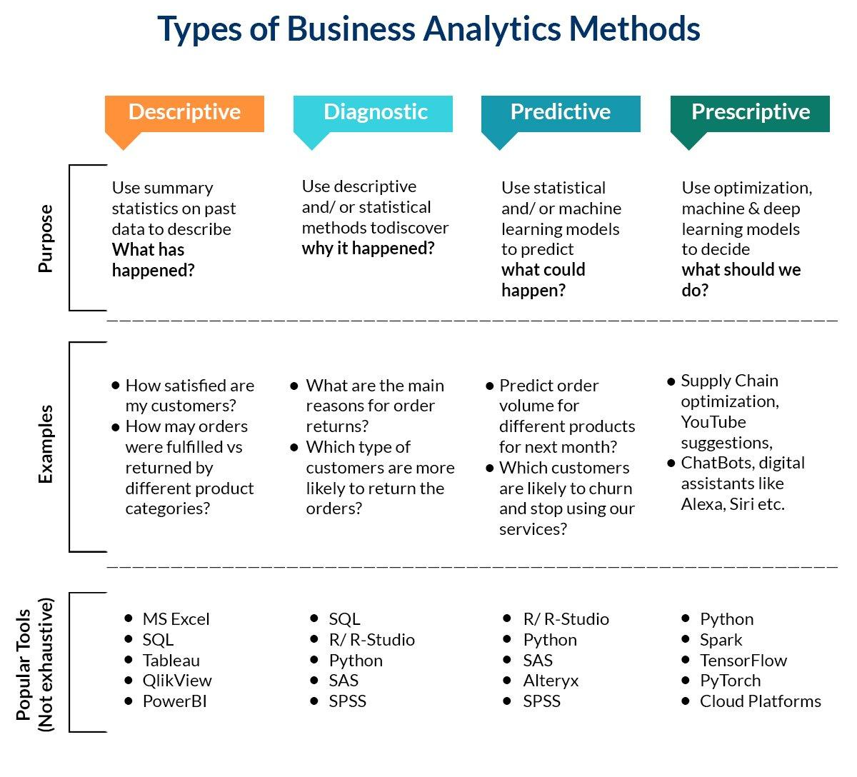
Introduction to business analytics and Concepts of business analytics
Types of Business Analytics Methods
Descriptive Analytics
Diagnostic Analytics
Predictive Analytics
Prescriptive Analytics
Image Source: https://www.analytixlabs.co.in/blog/what-is-business-analytics/
Notes:
Left (White Color space):
Title - Parent Topic
Subtitle - Subtopic 1
Body Text - Description in bullets
Right (Grey Color Space):
Body Text - Relevant image (with source)/code snippet
Put reference links in Speaker Notes
Reference:
https://www.tutorialspoint.com/internet_technologies/internet_overview.htm/

Slide 11
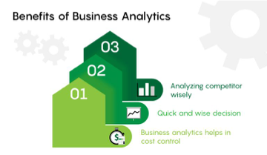
Introduction to business analytics and Concepts of business analytics
Uses and Benefits of Business Analytics
To carry out data mining and exploring new data to find new patterns and relationships.
To carry out statistical and quantitative analysis to provide explanations for certain occurrences.
Image Source: https://www.analytixlabs.co.in/blog/business-analytics-career/
Notes:
Left (White Color space):
Title - Parent Topic
Subtitle - Subtopic 1
Body Text - Description in bullets
Right (Grey Color Space):
Body Text - Relevant image (with source)/code snippet
Put reference links in Speaker Notes
Reference:
https://www.tutorialspoint.com/internet_technologies/internet_overview.htm/

Slide 12
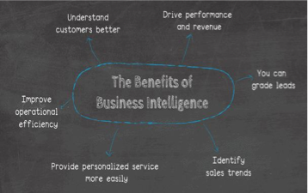
Introduction to business analytics and Concepts of business analytics
Uses and Benefits of Business Analytics
Test previous decisions are taken with the help of A/B testing and multivariate testing.
Deploy predictive modeling to predict future outcomes
Image Source: https://www.datapine.com/blog/benefits-of-business-intelligence-and-business-an
Notes:
Left (White Color space):
Title - Parent Topic
Subtitle - Subtopic 1
Body Text - Description in bullets
Right (Grey Color Space):
Body Text - Relevant image (with source)/code snippet
Put reference links in Speaker Notes
Reference:
https://www.tutorialspoint.com/internet_technologies/internet_overview.htm/

Slide 13
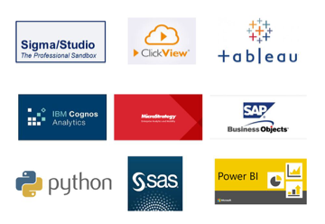
Introduction to business analytics and Concepts of business analytics
Business Analytics Tools
SQL
Tableau/ QlikView/ Power BI
Birt
Python ●R
MS Excel
Sisense
Clear Analytics
Pentaho BI
MicroStrategy
Image Source: https://sigma4sap.com/?page_id=466
Notes:
Left (White Color space):
Title - Parent Topic
Subtitle - Subtopic 1
Body Text - Description in bullets
Right (Grey Color Space):
Body Text - Relevant image (with source)/code snippet
Put reference links in Speaker Notes
Reference:
https://www.tutorialspoint.com/internet_technologies/internet_overview.htm/

Slide 14
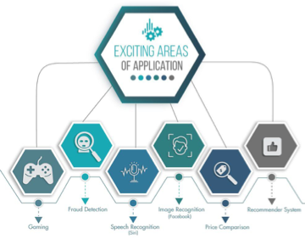
Introduction to business analytics and Concepts of business analytics
Applications of Business Analytics
Marketing
Finance
Human Resources
Manufacturing
Image Source: https://www.proschoolonline.com/certification-business-analytics-course/what-is-b
Notes:
Left (White Color space):
Title - Parent Topic
Subtitle - Subtopic 1
Body Text - Description in bullets
Right (Grey Color Space):
Body Text - Relevant image (with source)/code snippet
Put reference links in Speaker Notes
Reference:
https://www.tutorialspoint.com/internet_technologies/internet_overview.htm/

Slide 15
Trends in Business Analytics
Business Analytics Trends For 2021
Data Quality Management
Data Discovery/Visualization
Artificial Intelligence
Predictive and Prescriptive Analytics
Tools
Collaborative Business Intelligence
Data-driven Culture
Image Source: https://www.datapine.com/blog/benefits-of-business-intelligence-and-business-an
Notes:
Left (White Color space):
Title - Parent Topic
Subtitle - Subtopic 1
Body Text - Description in bullets
Right (Grey Color Space):
Body Text - Relevant image (with source)/code snippet
Put reference links in Speaker Notes
Reference:
https://www.tutorialspoint.com/internet_technologies/internet_overview.htm/

Slide 16
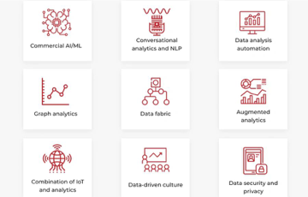
Trends in Business Analytics
Business Analytics Trends For 2021
Augmented Analytics
Mobile BI
Data Automation
Embedded Analytics
Natural language processing
Image Source: https://codeit.us/blog/top-data-and-analytics-trends
Notes:
Left (White Color space):
Title - Parent Topic
Subtitle - Subtopic 1
Body Text - Description in bullets
Right (Grey Color Space):
Body Text - Relevant image (with source)/code snippet
Put reference links in Speaker Notes
Reference:
https://www.tutorialspoint.com/internet_technologies/internet_overview.htm/

Slide 17
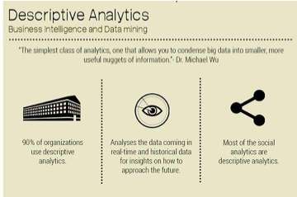
Descriptive analytics
What is Descriptive Analytics?
Descriptive analytics is a statistical method that is used to search and summarize historical data in order to identify patterns or meaning.
Descriptive analytics are based on standard aggregate functions in databases
Image Source: https://www.dezyre.com/article/types-of-analytics-descriptive-predictive-prescriptiv
Notes:
Left (White Color space):
Title - Parent Topic
Subtitle - Subtopic 1
Body Text - Description in bullets
Right (Grey Color Space):
Body Text - Relevant image (with source)/code snippet
Put reference links in Speaker Notes
Reference:
https://www.tutorialspoint.com/internet_technologies/internet_overview.htm/

Slide 18
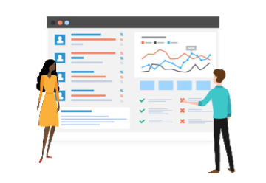
Descriptive analytics
What is Descriptive Analytics?
(Contd)
For example, in an online learning course with a discussion board, descriptive analytics could determine how many students participated in the discussion, or how many times a particular student posted in the discussion forum.
Image Source: https://www.valamis.com/hub/descriptive-analytics
Notes:
Left (White Color space):
Title - Parent Topic
Subtitle - Subtopic 1
Body Text - Description in bullets
Right (Grey Color Space):
Body Text - Relevant image (with source)/code snippet
Put reference links in Speaker Notes
Reference:
https://www.tutorialspoint.com/internet_technologies/internet_overview.htm/

Slide 19

Descriptive analytics
How does descriptive analytics work?
Data aggregation and data mining are two techniques used in descriptive analytics to discover historical data.
Data is first gathered and sorted by data aggregation in order to make the datasets more manageable by analysts.
Image Source: https://www.dataversity.net/fundamentals-descriptive-analytics/
Notes:
Left (White Color space):
Title - Parent Topic
Subtitle - Subtopic 1
Body Text - Description in bullets
Right (Grey Color Space):
Body Text - Relevant image (with source)/code snippet
Put reference links in Speaker Notes
Reference:
https://www.tutorialspoint.com/internet_technologies/internet_overview.htm/

Slide 20
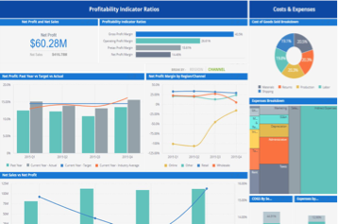
Descriptive analytics
How does descriptive analytics work?
(Contd)
Data mining describes the next step of the analysis and involves a search of the data to identify patterns and meaning.
Identified patterns are analyzed to discover the specific ways that learners interacted with the learning content and within the learning environment.
Image Source: hhttps://www.sisense.com/glossary/descriptive-analytics/
Notes:
Left (White Color space):
Title - Parent Topic
Subtitle - Subtopic 1
Body Text - Description in bullets
Right (Grey Color Space):
Body Text - Relevant image (with source)/code snippet
Put reference links in Speaker Notes
Reference:
https://www.tutorialspoint.com/internet_technologies/internet_overview.htm/

Slide 21
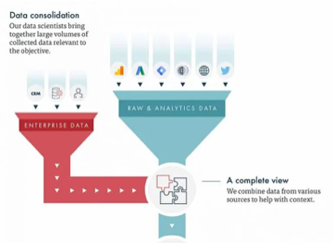
Descriptive analytics
Examples of descriptive analytics
Tracking course enrolment's, course compliance rates,
Recording which learning resources are accessed and how often
Summarizing the number of times a learner posts in a discussion board
Tracking assignment and assessment grades
Image Source: https://www.vertical-leap.uk/blog/data-science-for-marketers-part-2-descriptive-v-
Notes:
Left (White Color space):
Title - Parent Topic
Subtitle - Subtopic 1
Body Text - Description in bullets
Right (Grey Color Space):
Body Text - Relevant image (with source)/code snippet
Put reference links in Speaker Notes
Reference:
https://www.tutorialspoint.com/internet_technologies/internet_overview.htm/

Slide 22
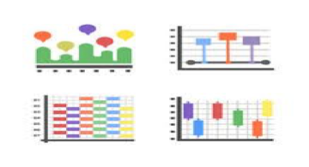
Descriptive analytics
Examples of descriptive analytics
(Contd)
Comparing pre-test and post-test assessments
Analyzing course completion rates by learner or by course
Collating course survey results
Identifying length of time that learners took to complete a course
Image Source: https://www.vectorstock.com/royalty-free-vector/data-analytics-icons-flat-pack-vec
Notes:
Left (White Color space):
Title - Parent Topic
Subtitle - Subtopic 1
Body Text - Description in bullets
Right (Grey Color Space):
Body Text - Relevant image (with source)/code snippet
Put reference links in Speaker Notes
Reference:
https://www.tutorialspoint.com/internet_technologies/internet_overview.htm/

Slide 23
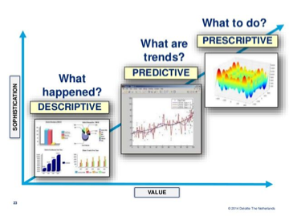
Descriptive analytics
Advantages of descriptive analytics
Quickly and easily report on the Return on Investment (ROI) by showing how performance achieved business or target goals.
Identify gaps and performance issues early - before they become problems.
Image Source: https://forums.bsdinsight.com/threads/descriptive-predictive-and-prescriptive-anal
Notes:
Left (White Color space):
Title - Parent Topic
Subtitle - Subtopic 1
Body Text - Description in bullets
Right (Grey Color Space):
Body Text - Relevant image (with source)/code snippet
Put reference links in Speaker Notes
Reference:
https://www.tutorialspoint.com/internet_technologies/internet_overview.htm/

Slide 24
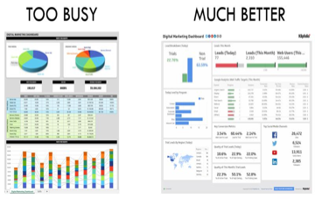
Descriptive analytics
Advantages of descriptive analytics
(Contd)
Identify specific learners who require additional support, regardless of how many students or employees there are
Identify successful learners in order to offer positive feedback or additional resources.
Analyze the value and impact of course design and learning resources.
Image Source: https://econsultancy.com/analytics-approaches-every-marketer-should-know-1-de
Notes:
Left (White Color space):
Title - Parent Topic
Subtitle - Subtopic 1
Body Text - Description in bullets
Right (Grey Color Space):
Body Text - Relevant image (with source)/code snippet
Put reference links in Speaker Notes
Reference:
https://www.tutorialspoint.com/internet_technologies/internet_overview.htm/

Slide 25
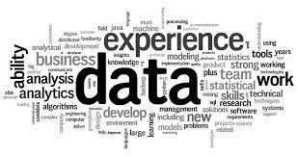
Introduction to Big Data Analytics
What is Data?
The quantities, characters, or symbols on which operations are performed by a computer, which may be stored and transmitted in the form of electrical signals and recorded on magnetic, optical, or mechanical recording media.
Image Source: https://encrypted-tbn0.gstatic.com/images?q=tbn:ANd9GcSCqNFP8VjcmqJX2EyEd-2mOaHcwSqTiXQVjCP1ISvmcIxoMYvCms5tQ_9imGeKaTmuBaA&usqp=CAU
Notes:
Left (White Color space):
Title - Parent Topic
Subtitle - Subtopic 1
Body Text - Description in bullets
Right (Grey Color Space):
Body Text - Relevant image (with source)/code snippet
Put reference links in Speaker Notes
Reference:
https://www.tutorialspoint.com/internet_technologies/internet_overview.htm/

Slide 26
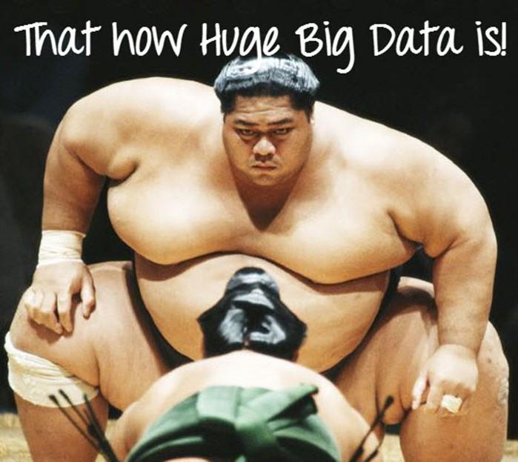
Introduction to Big Data Analytics
What is Big Data?
Big Data is a collection of data that is huge in volume, yet growing exponentially with time. It is a data with so large size and complexity that none of traditional data management tools can store it or process it efficiently. Big data is also a data but with huge size
Image Source: https://www.guru99.com/images/Big_Data/061114_0759_WhatIsBigDa1.jpg
Notes:
Left (White Color space):
Title - Parent Topic
Subtitle - Subtopic 1
Body Text - Description in bullets
Right (Grey Color Space):
Body Text - Relevant image (with source)/code snippet
Put reference links in Speaker Notes
Reference:
https://www.tutorialspoint.com/internet_technologies/internet_overview.htm/

Slide 27

Introduction to Big Data Analytics
Example of Big Data
The New York Stock Exchange is an example of Big Data that generates about one terabyte of new trade data per day.
Image Source: https://www.guru99.com/images/Big_Data/061114_0759_WhatIsBigDa2.jpg
Notes:
Left (White Color space):
Title - Parent Topic
Subtitle - Subtopic 1
Body Text - Description in bullets
Right (Grey Color Space):
Body Text - Relevant image (with source)/code snippet
Put reference links in Speaker Notes
Reference:
https://www.tutorialspoint.com/internet_technologies/internet_overview.htm/

Slide 28

Introduction to Big Data Analytics
Example of Big Data
Social Media
The statistic shows that 500+terabytes of new data get ingested into the databases of social media site Facebook, every day. This data is mainly generated in terms of photo and video uploads, message exchanges, putting comments etc.
Image Source: https://www.guru99.com/images/Big_Data/061114_0759_WhatIsBigDa3.jpg
Notes:
Left (White Color space):
Title - Parent Topic
Subtitle - Subtopic 1
Body Text - Description in bullets
Right (Grey Color Space):
Body Text - Relevant image (with source)/code snippet
Put reference links in Speaker Notes
Reference:
https://www.tutorialspoint.com/internet_technologies/internet_overview.htm/

Slide 29

Introduction to Big Data Analytics
Example of Big Data
A single Jet engine can generate 10+terabytes of data in 30 minutes of flight time. With many thousand flights per day, generation of data reaches up to many Petabytes.
Image Source: https://www.guru99.com/images/Big_Data/061114_0759_WhatIsBigDa4.jpg
Notes:
Left (White Color space):
Title - Parent Topic
Subtitle - Subtopic 1
Body Text - Description in bullets
Right (Grey Color Space):
Body Text - Relevant image (with source)/code snippet
Put reference links in Speaker Notes
Reference:
https://www.tutorialspoint.com/internet_technologies/internet_overview.htm/

Slide 30
Introduction to Big Data Analytics
Types Of Big Data
Following are the types of Big Data:
Structured
Unstructured
Semi-structured
Image Source: https://www.guru99.com/images/Big_Data/061114_0759_WhatIsBigDa4.jpg
Notes:
Left (White Color space):
Title - Parent Topic
Subtitle - Subtopic 1
Body Text - Description in bullets
Right (Grey Color Space):
Body Text - Relevant image (with source)/code snippet
Put reference links in Speaker Notes
Reference:
https://www.tutorialspoint.com/internet_technologies/internet_overview.htm/

Slide 31
Introduction to Big Data Analytics
Structured Big Data
Any data that can be stored, accessed and processed in the form of fixed format is termed as a ‘structured’ data.
Image Source: https://www.guru99.com/images/Big_Data/061114_0759_WhatIsBigDa4.jpg
Notes:
Left (White Color space):
Title - Parent Topic
Subtitle - Subtopic 1
Body Text - Description in bullets
Right (Grey Color Space):
Body Text - Relevant image (with source)/code snippet
Put reference links in Speaker Notes
Reference:
https://www.tutorialspoint.com/internet_technologies/internet_overview.htm/

Slide 32
Introduction to Big Data Analytics
Unstructured Big Data
Any data with unknown form or the structure is classified as unstructured data. In addition to the size being huge, un-structured data poses multiple challenges in terms of its processing for deriving value out of it.
Image Source: https://www.guru99.com/images/Big_Data/061114_0759_WhatIsBigDa4.jpg
Notes:
Left (White Color space):
Title - Parent Topic
Subtitle - Subtopic 1
Body Text - Description in bullets
Right (Grey Color Space):
Body Text - Relevant image (with source)/code snippet
Put reference links in Speaker Notes
Reference:
https://www.tutorialspoint.com/internet_technologies/internet_overview.htm/

Slide 33
Introduction to Big Data Analytics
Semi-structured Big Data
Semi-structured data can contain both the forms of data. We can see semi-structured data as a structured in form but it is actually not defined with e.g. a table definition in relational DBMS.
Image Source: https://www.guru99.com/images/Big_Data/061114_0759_WhatIsBigDa4.jpg
Notes:
Left (White Color space):
Title - Parent Topic
Subtitle - Subtopic 1
Body Text - Description in bullets
Right (Grey Color Space):
Body Text - Relevant image (with source)/code snippet
Put reference links in Speaker Notes
Reference:
https://www.tutorialspoint.com/internet_technologies/internet_overview.htm/

Slide 34
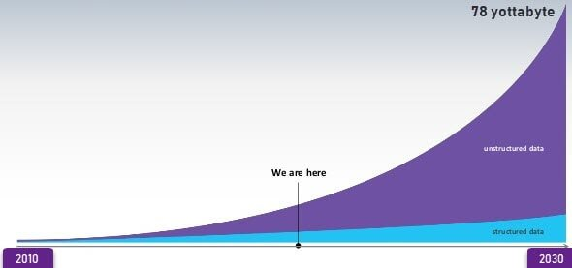
Introduction to Big Data Analytics
Data Growth over the years
Notes:
Left (White Color space):
Title - Parent Topic
Subtitle - Subtopic 1
Body Text - Description in bullets
Right (Grey Color Space):
Body Text - Relevant image (with source)/code snippet
Put reference links in Speaker Notes
Reference:
https://www.tutorialspoint.com/internet_technologies/internet_overview.htm/

Slide 35
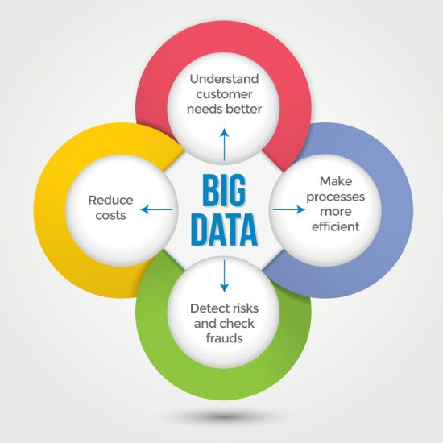
Introduction to Big Data Analytics
Characteristics Of Big Data
Big data can be described by the following characteristics:
Volume
Variety
Velocity
Variability
Image Source: https://qph.cf2.quoracdn.net/main-qimg-b093fe2a8f3d7ed42897bd85c33a4075-lq
Notes:
Left (White Color space):
Title - Parent Topic
Subtitle - Subtopic 1
Body Text - Description in bullets
Right (Grey Color Space):
Body Text - Relevant image (with source)/code snippet
Put reference links in Speaker Notes
Reference:
https://www.tutorialspoint.com/internet_technologies/internet_overview.htm/

